Slide 1
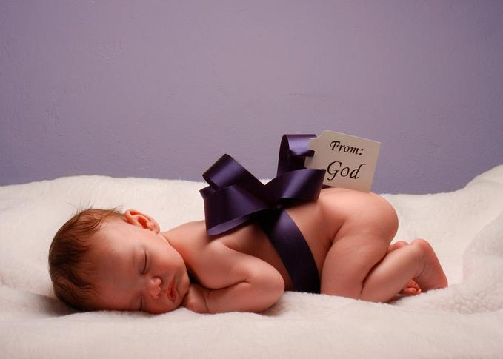
Children Are Forever!
Tommy's Window
Slideshow
♫ Turn on your speakers
CLICK TO ADVANCE SLIDES
Copyright © 2008 Tommy's Window. All Rights Reserved
Text by David Brandt Berg

Slide 2
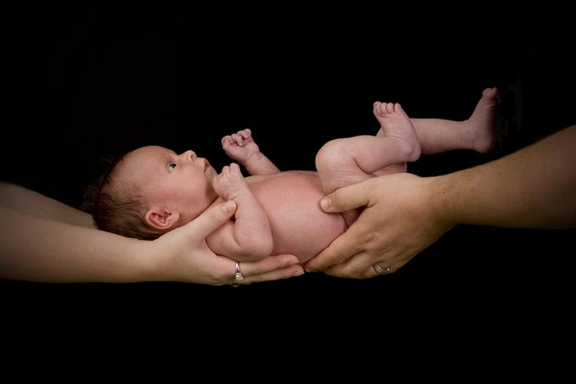
Bearing babies and raising children is the
greatest experience in this natural life.
Children are eternal gifts
—not just for a time,
but for eternity.

Slide 3
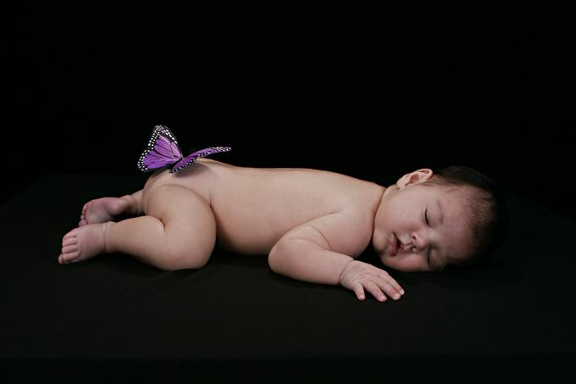
Babies are so close to God
—straight from Heaven.
Although it's very mysterious how the Lord plans and orders His creation, we know that He does not make any mistakes. God is the Creator of souls. He's the one who creates that spark of life, the union of spirit and body to form a human soul.

Slide 4
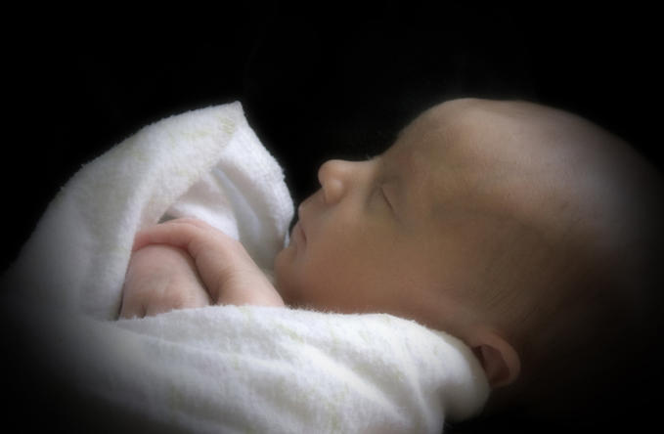
Of course children are not only a gift of God,
but also the work of God.
If God has given you children, then your first duty to God is to raise those children right. Your children are God's work for you. They're His children too, of course, but He wants you to take care of and train them.

Slide 5
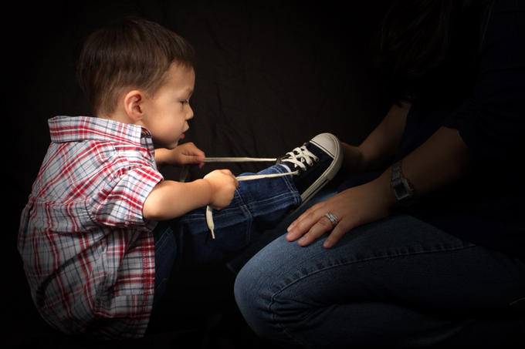
That's a full-time job, but with that big job come big rewards and lots of benefits. You should be very proud to be a parent, because yours is the greatest work in the world—molding the future.
The world of tomorrow is what the parents of today make it,
according to the way they raise their children.

Slide 6
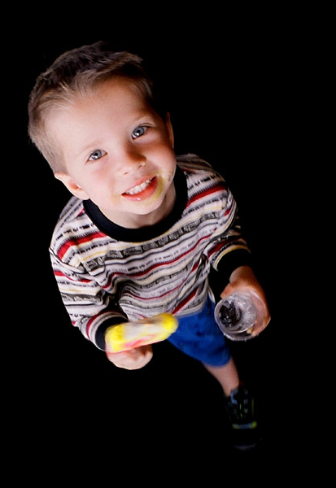
Never minimize the training of your children.
Did you ever realize that the most important things
children are going to learn in their lifetimes,
they learn before they're five years old?
So just think how important it is that you teach and train them right during those first formative years. That's why the Bible says, "Train up a child in the way he should go, and when he is old he will not depart from it"
(Proverbs 22:6).

Slide 7
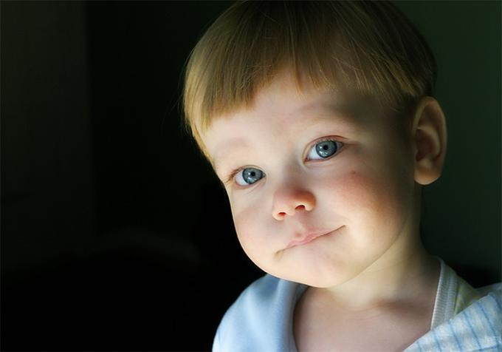
You can't wait till your child is five years old
before you begin teaching him or her.
Every single day counts,
and what that child learns
each day is important.
You as a parent are responsible to see to it that your child is not only fed, clothed, protected, and kept healthy, but also that your child is taught God's Word, trained in His truth, and inspired with His love.

Slide 8
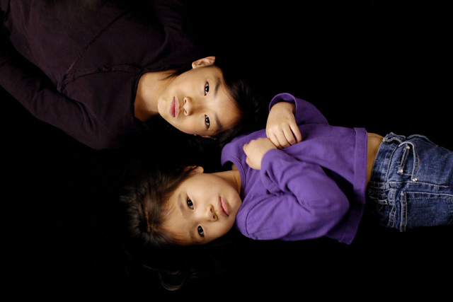
Some parents have the wrong attitude that if their kids learn, they learn, and if they don't, they don't.
While children shouldn't be forced to learn something they don't want to learn, the truth of the matter is that all children want to learn. They're happier and feel more fulfilled when they are learning, and they can learn a lot more with a parent's guidance and encouragement than if they are just left to learn on their own.

Slide 9
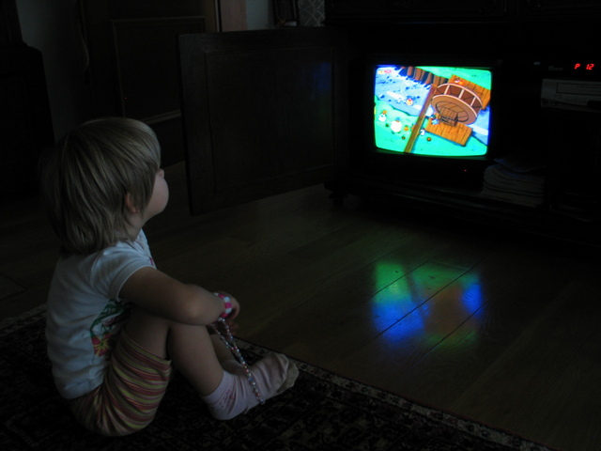
In fact, it is entirely unscriptural to leave children to make up their own minds without first trying to inform them and guide them in their decisions.
"A child left to himself
brings his mother
to shame."
Proverbs 29:15

Slide 10
Children's minds are just like sponges,
or tape recorders, or computers;
they absorb, record, and process
everything that goes on around them.
It's simple to teach your young children about Jesus. Just do it from your heart! Point them to the Lord by your example and your love, and by talking to them about Jesus.

Slide 11
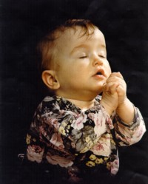
Jesus said,
"Let the little children
come to Me, and
do not forbid them;
for of such is
the kingdom of God."
Mark 10:14
He's just waiting to become
their Best Friend and Savior!

Slide 12
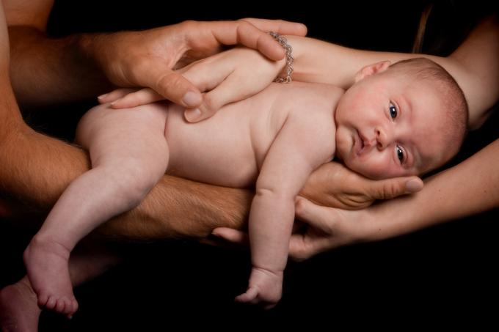
May God help us to be good stewards
of the most precious gifts He's given us...
...our children!
For more PowerPoint shows, visit:
www.tommyswindow.com

